Slide 1


Slide 2
studio.ml
Open-source tool for managing and sharing ML experiments
Capture experiment information
Artifact management and persistence
Seamless local, remote, and cloud running of experiments
Hyper-parameter search
Why?
Archival and Delivery Mechanism for Models
Model Zoo
App Store for LEAF
✓ Auditable
✓ Reproducible
✓ Collaborative
✓ Reusable
✓ Nonintrusive
✓ Scalable

Slide 3
StudioML at Scale Motivation / Use Case
Core objectives
Cost containment
Deep mind
$371K per employee in staff costs (Doubling YoY)¹
$618K per employee in expenses (Doubling YoY)¹
Ease of use
Python based research computing eco-system
Scale
Addressing compute needs without cloud privilege, 512 TPUs 1-2 days²
StudioML Distributed Computing, combines 3 earlier technologies (Solution)
¹ Business Insider Oct 2018, ² https://arxiv.org/abs/1809.11096 .

Slide 4
The good news is that AI can now give you a more believable image of a plate of spaghetti. The bad news is that it used roughly enough energy to power Cleveland for the afternoon.
Jer Thorpe
https://twitter.com/blprnt/status/1046480155013713921

Slide 5
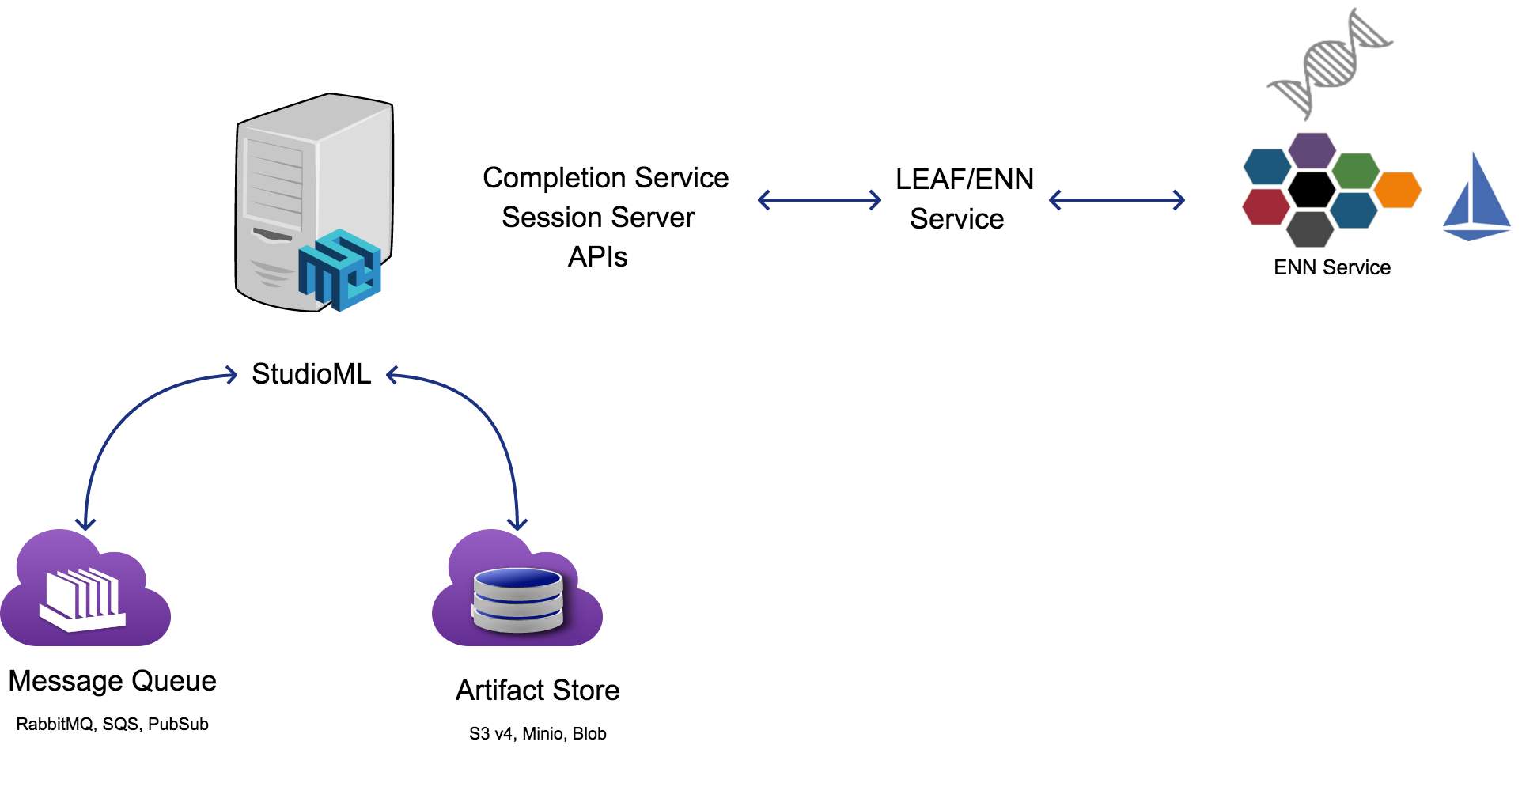
StudioML Experimenter Perspective

Slide 6
Project Structure
StudioML Python
General Purpose ML/AI Development
Execution Limitations (scale and single user)
StudioML Go Runner
Extensible and custom deployment options
Enables Scalable and Shared infrastructure
Session Server and Completion Service
Internal and partner contrib style APIs

Slide 7
StudioML Python Demo
Trivial TF/Keras task no ENN
Python virtualenv packaging
Github Tour

Slide 8
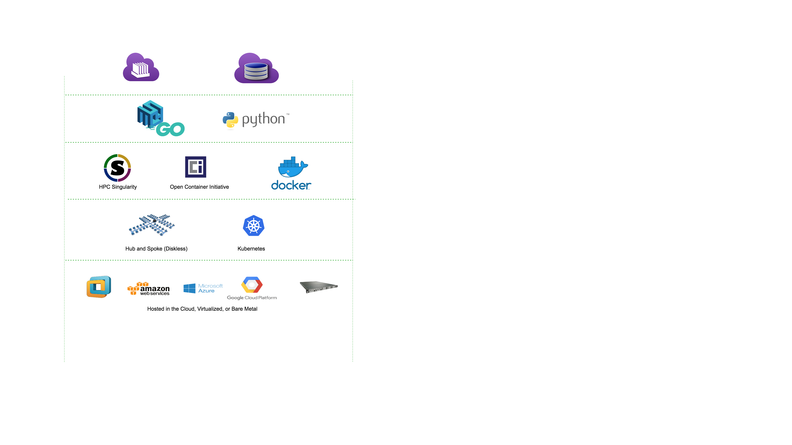
Go Runner

Slide 9
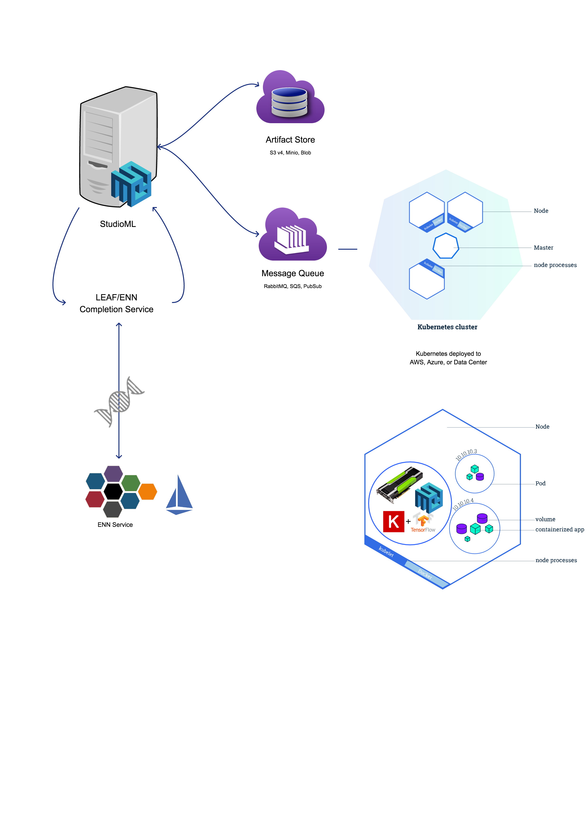
Distributed StudioML
Distributed Evolution:

Slide 10
Clusters - Kubernetes
Common platform
Data Center
Multi-Cloud
Diverse workloads within clusters
Namespaces
Partitioning

Slide 11
Kubernetes Hands-on Overview
Production Cluster Tour
Namespaces, service and application partitioning, and CI/CD

Slide 12
StudioML Go Runner Use Cases
Singularity A container runtime for HPC as an alternative to Python centric workloads
Kubernetes StudioML scheduled as a Job and as a Deployment
Virtualization At a container (Untrusted), or python virtualenv (trusted)
Agnostic With/without Kubernetes and diverse hardware

Slide 13
StudioML & Go Runner Roadmap
MultiGPU Recently completed
Meta-data protobuf, TensorFlow, kubeflow, StudioML progeny
Kubernetes Operators and explicit spot instance support

